Slide 1
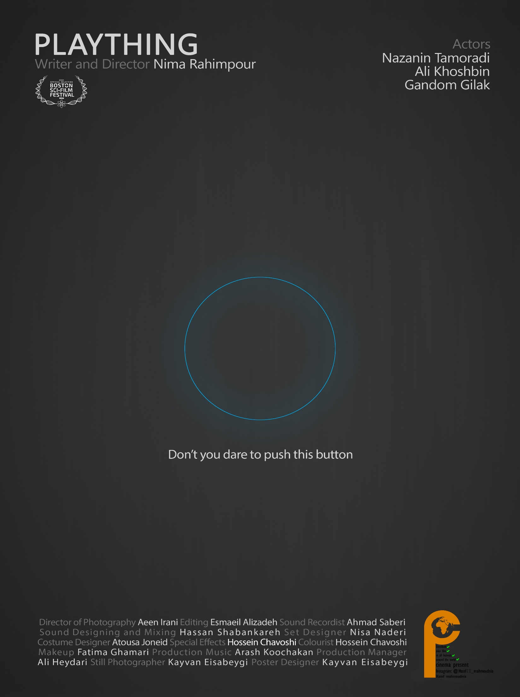

Slide 2
Tag line:
Don’t you dare push this button
Log line:
Nima doesn’t like his new doll. He wants his mother’s love and attention.
Short synopsis:
After a long wait, Nima receives his favorite toy. His mother's bought a doll for him which is truly like a real human baby. Nima has a smart playmate now.
It doesn’t take long when Nima’s interest in and enthusiasm for the toy gives way to anger and hatred. Nima feels that his mother pays more attention to the doll than him and treats the doll like a real human baby.

Slide 3
The story:
Nothing seems amusing to Nima anymore. Nima cannot wait to see his new toy. His mother takes Nima's new toy. It’s a doll which is like a real human baby from every aspect.
His mother reminds Nima that turning the doll off will definitely damage him. He should never even think about doing such a thing.
Everything goes well fine between Nima and his new doll until the doll starts making trouble for him. The doll destroys Nima’s tower. However, what makes Nima so furious about is his mother who supports the doll not him.
Nima cannot stand his mother’s meticulous attention to his doll and ignoring him. If this is ‘his’ doll, he should decide how to treat it. Now, it is time to turn the doll off and make his mom know that he is more important than a doll.
Turning off the toddler toy, outrages mom and she decides to punish Nima. This time differently however; she switches off nima…

Slide 4
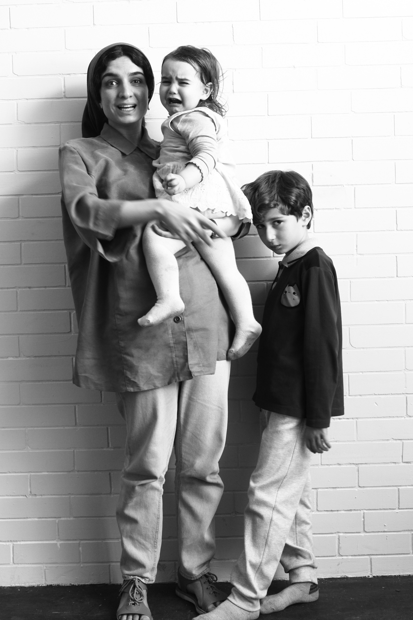
Photo:
Kayvan Eisabeygi

Slide 5
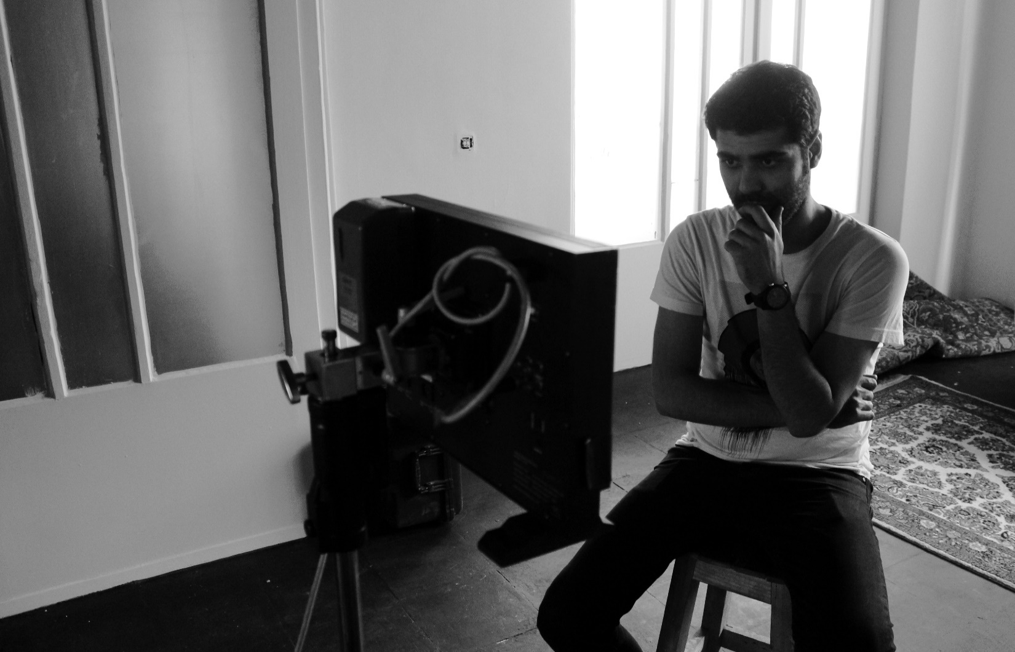
Director’s Bio:
Nima Rahimpour is an Iranian filmmaker & screenwriter based in Tehran, Iran.
He graduated of Film Direction-cinema from Islamic Azad University of Bushehr (2015) and then graduated of Script Writing from Cinematic Studies Department of Ministry of Culture (2018)
Nima started his professional career by screen writing the “Pale Blue Dot” (Short Film)
After the success of this screenplay, he wrote several other scripts, mostly for short films.
Nima was awarded the “Best Screenplay” for his screenplay “The Baby Sister” from the “Alame Lere Rahmat” Film Festival in 2019, Turkey.
“Plaything” is his first film, based on the short story by “Bruce Holland Rogers”.

Slide 6
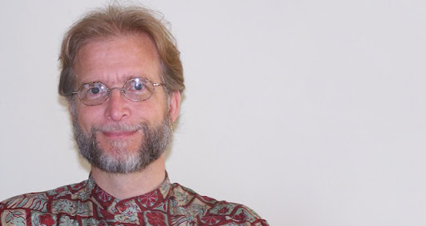
Dear Nima Rahimpour,
I have watched your film twice now, first without subtitles and then a second time with.
I can not find adequate words to express how much I love your creation. It is visually attractive, well-paced, and highly entertaining. As a story writer, I naturally want any collaborator to create something that is faithful to my own work, yet successful on its own terms. For everyone else, that second criterion is more important than the first, but I'm quite pleased to say that you have, in my view, accomplished both.
“Bruce Holland Rogers”

Slide 7
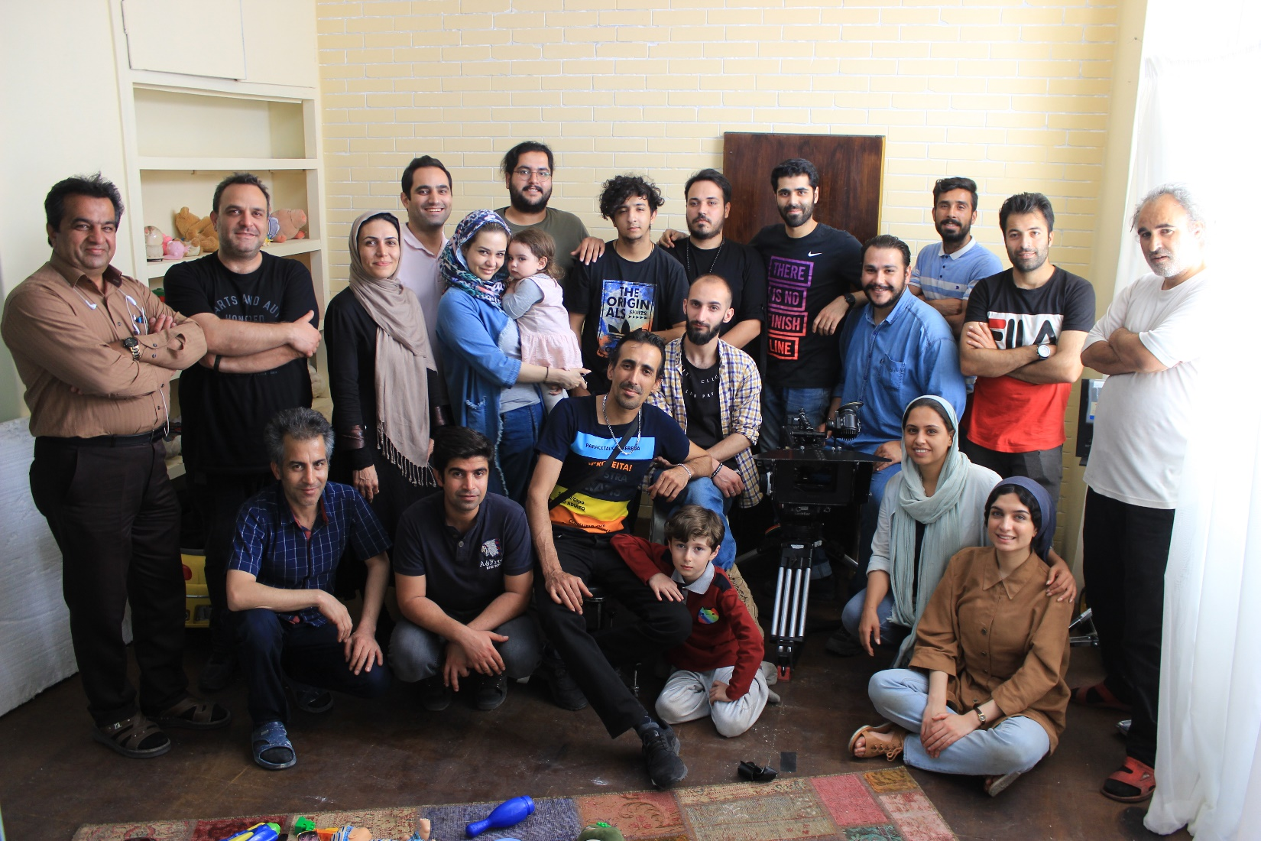
Cast and Crew Credits:
Writer and Director: Nima Rahimpour
Director of Photography: Aeen Irani
Editing: Esmaeil Alizadeh
Sound recordist: Ahmad Saberi
Sound Designing and Mixing: Hassan Shabankareh
Set Designer: Nisa Naderi
Costume Designer: Atousa Joneid
Special Effects: Hossein Chavoshi
Music: Arash Kouchakan
Makeup: Fatima Ghamari
Producer Manager: Ali Heydari
Producer: Nima Rahimpour

Slide 8
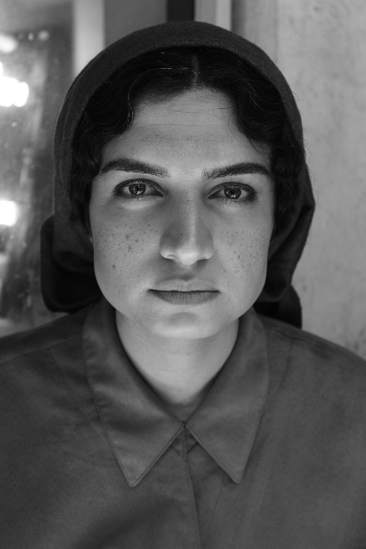
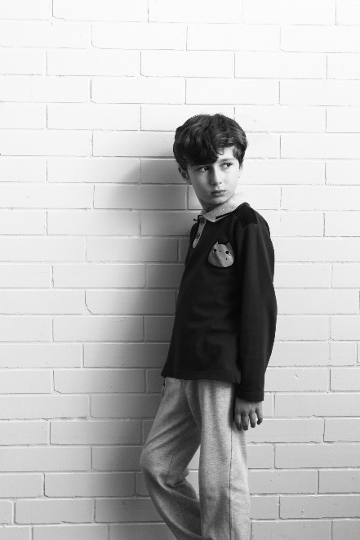
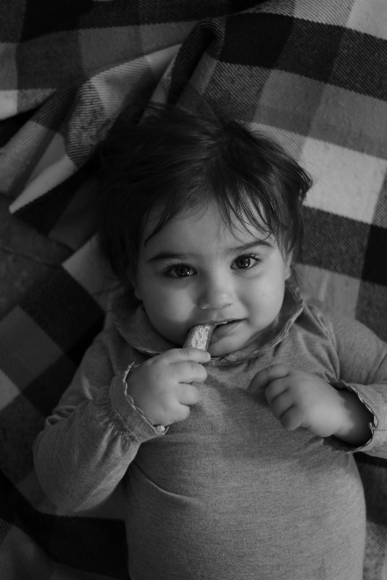
Nazanin Tamoradi:
Mother
Ali Khoshbin:
Nima
Gandom Gilak:
Gandom

Slide 9
Director’s Statement:
About seven years ago, as I read this story, I decided to film it. Then, I did not have the conditions to make such a film. After seven years, I returned to the story. I have always been thinking about making such a film since the first day, and the story did not seem old to me yet. It was very precious to me to have the same concerns as an author who is miles away from me; the one from a different culture and lifestyle. I was mentally connected to him. I had to film this story...
To recognize the right of copyright, I contacted Bruce (the writer) and he enthusiastically accepted my request.
The film is not such a distant future story. We live near such a world:
a world where affection is buyable;
a world where men and women do not need each other to start a family;
a world where nobody even knows his/her true identity;
near a scary and tempting world ...

Slide 10
Specifications
Title: Plaything
Running Time: 13:30 mins
Screening Format: ARRIRAW/ Quick time
Aspect Ratio: (2:39.1 Letterbox)
Sound: Stereo / 5.1 Surround Sound
Country of Production: Iran
Year: 2019
Language: Persian

Slide 11
FAQs
How long did the project take?
The screenplay took about 6 months. Pre-production lasted about 2 months. We shot the project in about 9 days. Picture edit took 2 months. Sound and music recording and editing took 1 month. From the start of the screenplay to the first official screening, it took one year.
2. How did you meet your film budget?
I made a significant portion of the budget by selling my house. Additional help came from family members.
3. How long did the special effects of the film take?
From the beginning of the pre-production, we were in contact with the special effects manager. He controlled all the details and checked all the points with us. During days of shooting, special effects team were present at the scene. Eventually, it all ended 6 months after the film was made.

Slide 12
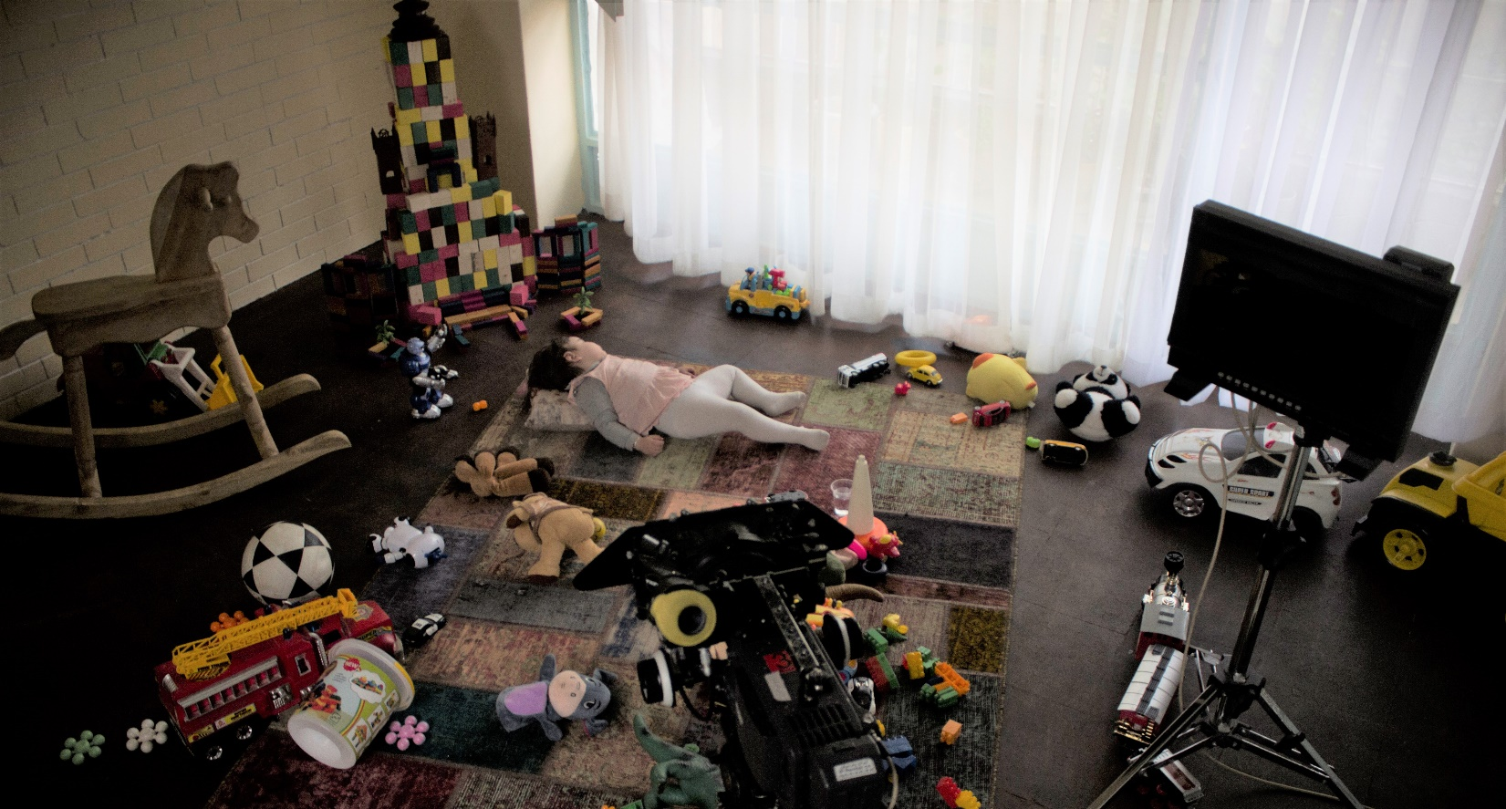

FAQs
4. How did you work with a child?
A hard but enjoyable experience. We monitored the child all the time. We tried to understand his reactions and use them when needed. But then the most important thing in working with child, is that it is we who must be coordinated with the toddler. The baby is never in tune with the film crew

